Slide 1
Female Reproductive System
Al-Farabi Kazakh National University
Higher School of Medicine
Anatomy, Puberty and Menopause

Slide 2
LEARNING OUTCOMES
As a result of the lesson you will be able to:
describe the structure of the ovary;
trace the female reproductive tract and describe the gross anatomy and histology of each organ;
identify the ligaments that support the female reproductive organs;
describe the blood supply to the female reproductive tract;
identify the external genitalia of the female;
describe the structure of the nonlactating breast.
name the hormones that regulate female reproductive function, and state their roles;
describe the principal signs of puberty;
describe the hormonal changes of female climacteric and their effects;
define and describe menopause, and distinguish menopause from climacteric.
Al-Farabi Kazakh National University
Higher School of Medicine

Slide 3
Female Reproductive System
internal genitalia
ovaries
uterine tubes
uterus and vagina
external genitalia
clitoris
labia minora
labia majora
Al-Farabi Kazakh National University
Higher School of Medicine

Slide 4
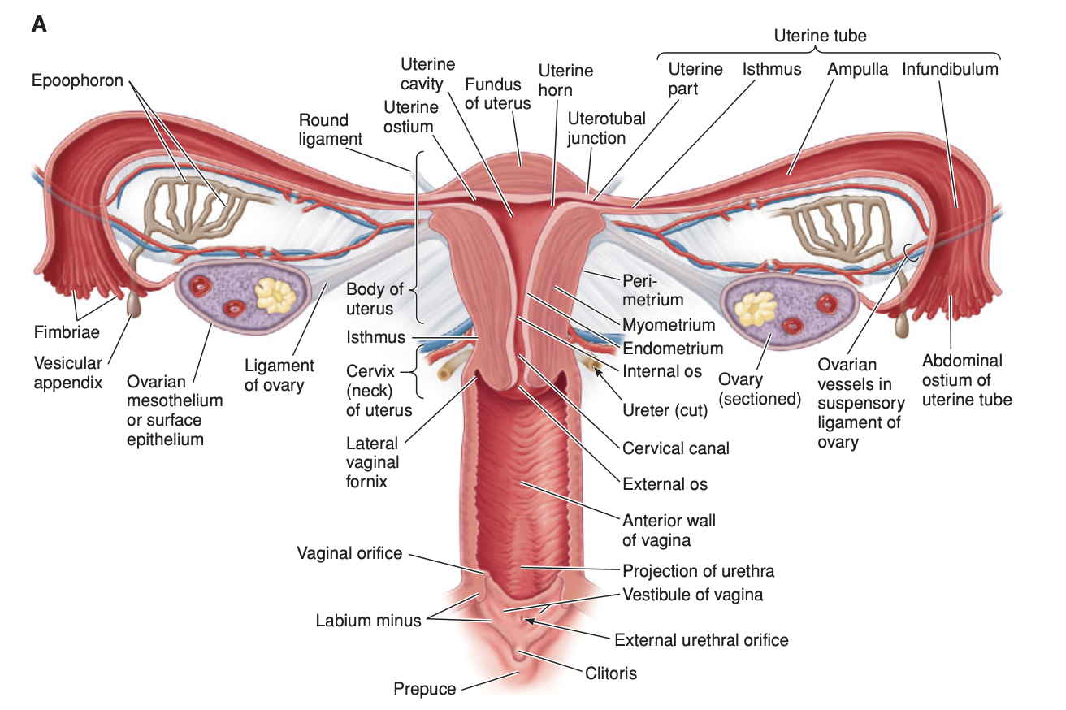
Figure from: Ronald W. Dudek , High-Yield Gross Anatomy , McGraw Hill, 2015
Al-Farabi Kazakh National University
Higher School of Medicine

Slide 5
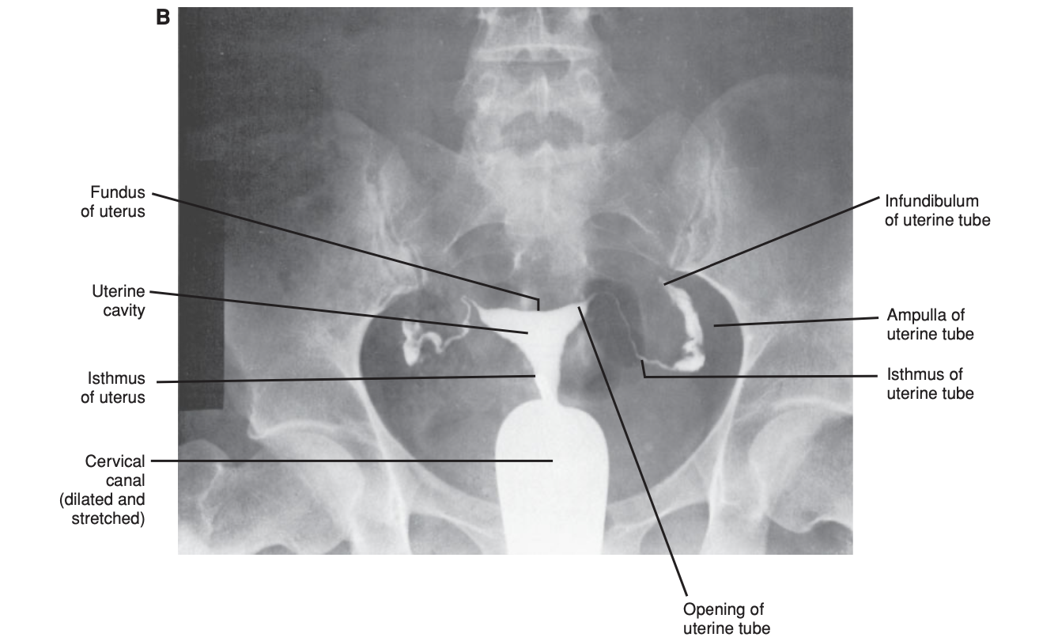
Figure from: Ronald W. Dudek , High-Yield Gross Anatomy , McGraw Hill, 2015
Al-Farabi Kazakh National University
Higher School of Medicine

Slide 6
The Ovaries
female gonads which produce egg cells (ova) and sex hormones
A. General Features
Almond-shaped structures, located posterior to the broad ligament.
Attached to the lateral pelvic wall by the suspensory ligament of the ovary (a region of the broad ligament), which contains the ovarian artery, vein, and nerve.
Attached to uterus by ovarian ligament
The surface of the ovaries covered by a simple cuboidal epithelium called the germinal epithelium.
Al-Farabi Kazakh National University
Higher School of Medicine

Slide 7
The Ovaries
A. General Features
tunica albuginea capsule
outer cortex - germ cells develop
inner medulla occupied by major arteries and veins
lacks ducts, instead each egg develops in its own fluid-filled follicle
ovulation – bursting of the follicle and releasing the egg
Al-Farabi Kazakh National University
Higher School of Medicine

Slide 8
The Ovaries
B. Arterial Supply.
from the ovarian arteries, which arise from the abdominal aorta, and ascending branches of the uterine arteries, which arise from the internal iliac artery.
C. Venous Drainage.
the right ovarian vein (the inferior vena cava) and the left ovarian vein (left renal vein).
D. Lymph Drainage.
The lymph drainage of the ovary is to the lateral aortic nodes.
Al-Farabi Kazakh National University
Higher School of Medicine

Slide 9
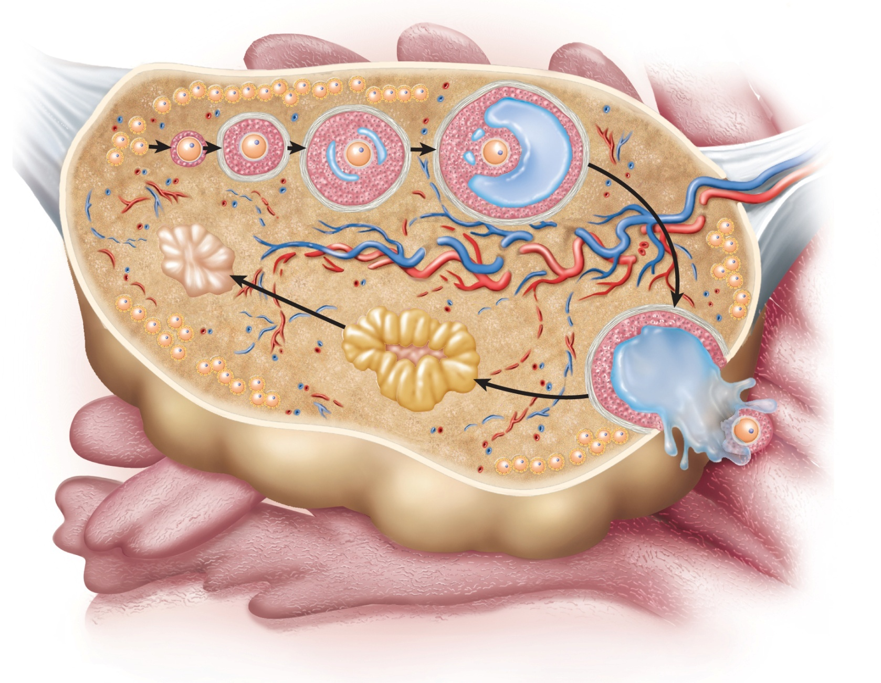
Anatomy of Ovary
Copyright © The McGraw-Hill Companies, Inc. Permission required for reproduction or display.
Primordial
follicles
Primary
follicles
Secondary
follicle
Mature
follicle
Oocyte
Suspensory ligament
and blood vessels
Ovarian
ligament
Medulla
Cortex
Tunica
albuginea
Corpus
albicans
Corpus
luteum
Fimbriae
of uterine
tube
Ovulated
oocyte
Figure from: Saladin, Anatomy & Physiology, McGraw Hill, 2018
Figure 28.2

Slide 10
The Uterine Tubes
uterine tube (oviduct) or (fallopian tube) - convey fertilized and unfertilized oocytes to the uterine cavity by ciliary action and muscular contractions and to transport sperm in the opposite direction for fertilization to take place.
A. General Features
mesosalpinx, a region of the broad ligament support the uterine tube
The infundibulum is funnel-shaped, is fimbriated, and opens into the peritoneal cavity.
The ampulla is the longest and widest part of the uterine tube. It is the site of fertilization.
Isthmus is narrower end toward uterus
The intramural division opens into the uterine cavity.
Al-Farabi Kazakh National University
Higher School of Medicine

Slide 11
The Uterine Tubes
B. Arterial Supply
The arterial supply of the uterine tubes is from the ovarian arteries, which arise from the abdominal aorta, and the ascending branches of the uterine arteries, which arise from the internal iliac artery.
C. Venous Drainage.
The venous drainage of the uterine tubes is to the right ovarian vein (empty into IVC), the left ovarian vein (empty into the left renal vein), and the uterine veins.
Al-Farabi Kazakh National University
Higher School of Medicine

Slide 12
The Uterus
Pear-shaped ,thick muscular chamber that opens into the roof of the vagina, harbors fetus, provides a source of nutrition, and expels the fetus
A. General Features
fundus is located superior to the cornua and contributes largely to the upper segment of the uterus during pregnancy. (vertebral level T9).
The cornu is located near the entry of the uterine tubes.
The body is located between the cornu and cervix. The isthmus is part of the body and is the dividing line between the body of the uterus and the cervix.
cervix is located inferior to the body
Al-Farabi Kazakh National University
Higher School of Medicine

Slide 13
The Uterus
A. General Features
lumen is a potential space in the non-pregnant uterus
cervical canal connects the lumen to vagina
internal os – superior opening of the canal into the body of the uterus
external os – inferior opening of the canal into the vagina
cervical glands – secretes mucus that prevents the spread of microorganisms from the vagina to the uterus
Al-Farabi Kazakh National University
Higher School of Medicine

Slide 14
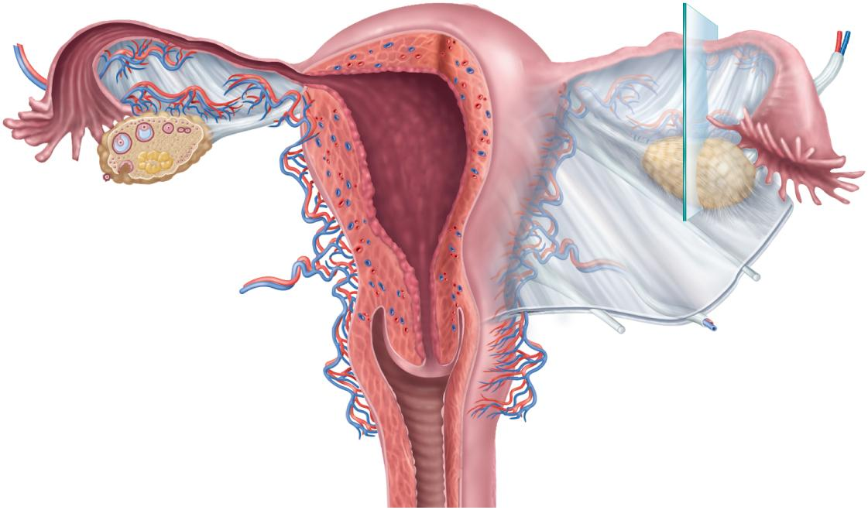
Uterus
Copyright © The McGraw-Hill Companies, Inc. Permission required for reproduction or display.
Infundibulum
Ampulla
Isthmus
Fundus
Body
Ovarian
ligament
Mesosalpinx
Uterine
tube
Ovarian artery
Ovarian vein
Suspensory
ligament
Fimbriae
Ovary
Myometrium
Mesometrium
Endometrium
Internal os
Round
ligament
Cervical canal
Cardinal
ligament
Lateral fornix
Uterosacral
ligament
Cervix
External os
Vagina
(a)
Figure 28.3a
Figure from: Saladin, Anatomy & Physiology, McGraw Hill, 2018

Slide 15
The Uterus
B. Uterine Wall
perimetrium - external serosa layer
myometrium - middle muscular layer
constitutes most of the uterine wall
composed mainly of smooth muscle
endometrium – inner mucosa
simple columnar epithelium, compound tubular glands, and a stroma populated with leukocytes, macrophages, and other cells.
stratum functionalis – superficial half, shed each menstrual period
stratum basalis - deep layer, stays behind and regenerates a new stratum functionalis with each menstrual cycle
during pregnancy, the endometrium is the site of attachment of the embryo and forms the maternal part of the placenta from which the fetus is nourished
Al-Farabi Kazakh National University
Higher School of Medicine

Slide 16
The Uterus
B. Uterine Wall
perimetrium - external serosa layer
myometrium - middle muscular layer
constitutes most of the uterine wall
composed mainly of smooth muscle
endometrium – inner mucosa
simple columnar epithelium, compound tubular glands, and a stroma populated with leukocytes, macrophages, and other cells.
stratum functionalis – superficial half, shed each menstrual period
stratum basalis - deep layer, stays behind and regenerates a new stratum functionalis with each menstrual cycle
during pregnancy, the endometrium is the site of attachment of the embryo and forms the maternal part of the placenta from which the fetus is nourished
Al-Farabi Kazakh National University
Higher School of Medicine

Slide 17
The Uterus
C. Support of the Uterus
Pelvic Diaphragm (Levator Ani Muscles)
Urogenital Diaphragm
Urinary Bladder
Ligament
cardinal (lateral cervical) ligaments
uterosacral ligaments
broad ligament
round ligaments
Al-Farabi Kazakh National University
Higher School of Medicine

Slide 18
What is the structural characteristic of broad ligment?
Al-Farabi Kazakh National University
Higher School of Medicine

Slide 19
The Uterus
C. Blood supply
uterine arteries, which arise from the internal iliac artery.
arcuate arteries
D.Venous Drainage.
The venous drainage of the uterus is to the internal iliac veins (empties into the IVC)
Al-Farabi Kazakh National University
Higher School of Medicine

Slide 20
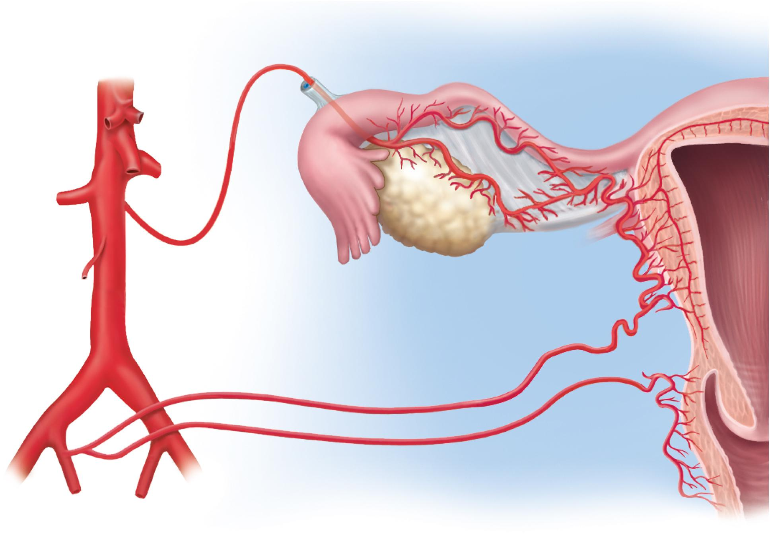
Vessels of Reproductive Tract
Copyright © The McGraw-Hill Companies, Inc. Permission required for reproduction or display.
Ovarian branch
of uterine artery
Arcuate artery
Suspensory
ligament
Aorta
Mesosalpinx
Uterine
artery
Common
iliac artery
Ovarian
artery
Ovary
Vaginal
artery
Internal iliac artery
Spiral arteries
Figure from: Saladin, Anatomy & Physiology, McGraw Hill, 2018
Figure 28.7

Slide 21
Vagina
vagina (birth canal) – Distensible muscular tube
A. General Features
allows for discharge of menstrual fluid, receipt of penis and semen, and birth of baby, The vagina is the longest part of the birth canal, and its distention during childbirth is limited by the ischial spine and sacrospinous ligaments.
extends from the cervix to the vestibule of the vagina.
outer adventitia, middle muscularis, and inner mucosa,no glands
tilted posteriorly between rectum and urethra
transudation lubricates vagina – “vaginal sweating”
Al-Farabi Kazakh National University
Higher School of Medicine

Slide 22
Vagina
A. General Features
fornices – blind-ended a recess around the cervix
Anterior fornix is located anterior to the cervix and is related to the vesicouterine pouch.
Lateral fornices are located lateral to the cervix.
Posterior fornix is located posterior to the cervix and is related to the rectouterine pouch (of Douglas).
transverse friction ridges (vaginal rugae) at lower end
mucosal folds form hymen across vaginal opening
Al-Farabi Kazakh National University
Higher School of Medicine

Slide 23
Vagina
B. Blood supply
the vaginal branches of uterine artery (arises from the internal iliac artery )supply superior portion of the vagina
the internal pudendal artery,(arises from the internal iliac artery) supply of the middle and lower portions of the vagina is from
C.Venous Drainage.
to the vaginal venous plexus (which is continuous with the uterine venous plexus), which empties into the internal iliac veins → IVC.
Al-Farabi Kazakh National University
Higher School of Medicine

Slide 24
The External Genitalia
the vulva or pudendum
mons pubis - mound of fat over pubic symphysis bearing most of the pubic hair
labia majora – pair of thick folds of skin and adipose tissue inferior to the mons
pudendal cleft – slit between labia majora
labia minora – medial to labia majora are thin hairless folds
space between forms vestibule which contains urethral and vaginal openings
anterior margins of labia minora join to form hood-like prepuce over clitoris
clitoris - erectile, sensory organ with no urinary role
vestibular bulbs - erectile tissue deep to the labia majora
greater and lesser vestibular and paraurethral glands open into vestibule for lubrication
Al-Farabi Kazakh National University
Higher School of Medicine

Slide 25
Breasts
Attach to the pectoralis major by suspensory ligaments, most of the time it contains very little mammary gland
A. General Features
nonlactating breast consists mostly of adipose and collagenous tissue
body – conical to pendulous, with the nipple at its apex
axillary tail – extension toward the armpit
lymphatics in axillary tail are important as a route for breast cancer metastasisnipple surrounded by circular colored zone the areola
nipple surrounded by circular colored zone the areola
more sensitive,blood capillaries and nerves closer to skin surface
sensory nerve fibers of areola trigger a milk ejection reflex when an infant nurses
areolar glands – intermediate between sweat glands and mammary glands
secretions protect the nipple from chapping and cracking during nursing
smooth muscle fibers in dermis of areola that contract in response to cold, touch, and sexual arousal wrinkling the skin and erecting the nipple
Al-Farabi Kazakh National University
Higher School of Medicine

Slide 26
Breasts
Attach to the pectoralis major by suspensory ligaments, most of the time it contains very little mammary gland
General Features
nonlactating breast consists mostly of adipose and collagenous tissue
body – conical to pendulous, with the nipple at its apex
axillary tail – extension toward the armpit
lymphatics in axillary tail are important as a route for breast cancer metastasisnipple surrounded by circular colored zone the areola
nipple surrounded by circular colored zone the areola
more sensitive,blood capillaries and nerves closer to skin surface
sensory nerve fibers of areola trigger a milk ejection reflex when an infant nurses
areolar glands – intermediate between sweat glands and mammary glands
secretions protect the nipple from chapping and cracking during nursing
smooth muscle fibers in dermis of areola that contract in response to cold, touch, and sexual arousal wrinkling the skin and erecting the nipple
Al-Farabi Kazakh National University
Higher School of Medicine

Slide 27
Mammary Glands
mammary gland - remains active in the lactating breast, atrophies when a woman ceases to nurse
system of ducts through fibrous stroma and converge on the nipple
mammary gland develops during pregnancy
15 to 20 lobes around the nipple, lactiferous duct drains each lobe
dilates to form lactiferous sinus which opens into the nipple
Al-Farabi Kazakh National University
Higher School of Medicine

Slide 28
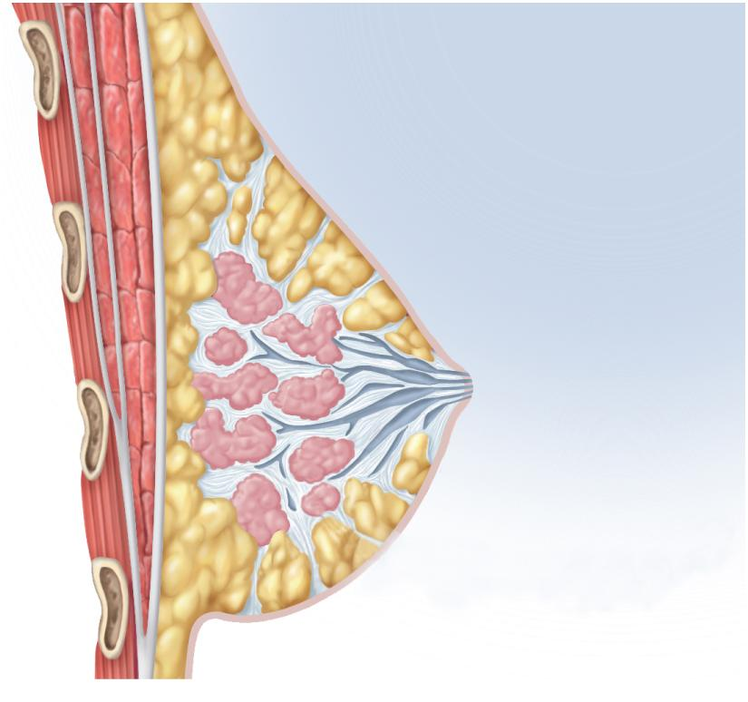
Anatomy of Lactating Breast
Copyright © The McGraw-Hill Companies, Inc. Permission required for reproduction or display.
Rib
Intercostal muscles
Pectoralis minor
Pectoralis major
Fascia
Suspensory ligament
Lobules
Lobe
Adipose tissue
Nipple
Lactiferous sinus
Lactiferous duct
Figure 28.9c
Figure from: Saladin, Anatomy & Physiology, McGraw Hill, 2018
(c) Sagittal section

Slide 29
Puberty
Female puberty(thelarche, pubarche , menarche )
triggered by rising levels of gonadotropin-releasing hormone (GnRH)
stimulates anterior lobe of pituitary to produce
follicle-stimulating hormone (FSH)
luteinizing hormone (LH)
follicle-stimulating hormone (FSH) stimulates developing ovarian follicles and they begin to secrete estrogen, progesterone, inhibin, and a small amount of androgen
estrogens are feminizing hormones with widespread effects on the body
estradiol (most abundant), estriol, and estrone
What is the difference between boy and girls puberty?

Slide 30
climacteric
Female climacteric -midlife change in hormone secretion
accompanied by menopause – cessation of menstruation
female born with about 2 million eggs, climacteric begins when there are about 1000 follicles left
Describe the principal cause of female climacteric
changes?

Slide 31
CASE STUDY
Al-Farabi Kazakh National University
Higher School of Medicine

Slide 32
Reference:
Saladin, Anatomy & Physiology, McGraw Hill, New York,2018
National center for case study teaching in science. https://sciencecases.lib.buffalo.edu/

